Slide 1
Supervised learning

Slide 2
What is supervised learning?
Supervised learning, also known as supervised machine learning, is a subcategory of machine learning and artificial intelligence. It is defined by its use of labeled data sets to train algorithms that classify data or predict outcomes accurately.
As input data is fed into the model, it adjusts its weights until the model has been fitted appropriately, which occurs as part of the cross-validation process. Supervised learning helps organizations solve for a variety of real-world problems at scale, such as classifying spam in a separate folder from your inbox. It can be used to build highly accurate machine learning models.

Slide 3
Types of supervised learning
Classification: Involves predicting a categorical label. Examples include spam detection in emails, image recognition, and disease diagnosis. The output is a class label, such as "spam" or "not spam.“
Regression: Involves predicting a continuous value. Examples include predicting house prices, stock prices, or temperature. The output is a real number, such as "$250,000" or "75°F.“
In Machine Learning an attribute is a data type (e.g., “Mileage”), while a feature has several meanings depending on the context, but generally means an attribute plus its value (e.g., “Mileage =15,000”). Many people use the words attribute and feature inter‐changeably, though.

Slide 4
Steps involved in supervised learning
Determine the type of training dataset
Collect/Gather the labelled training data
Split the training dataset into training dataset, test dataset
Determine the suitability algorithm for the model
Execute the algorithm on the training dataset.
Evaluate the accuracy of the model by providing the test set.

Slide 5
Supervised learning problem
Training set
Learning Algorithm
size
hypothesis
price

Slide 6

Design the learning algorithm such that..
$$h\left(x\right)=θ_{0}+θ_{1}x$$
Hypothesis with input feature x
Input feature
Parameter

Slide 7

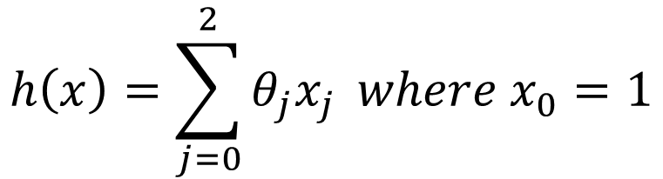

As the input features increase then..
$$h\left(x\right)=θ_{0}+θ_{1}x_{1}+θ_{2}x_{2}$$
Input feature 2
Hypothesis with input feature x
Parameter 1
Parameter 2
Input feature 1
$$h\left(x\right)=\sum_{j=0}^{2}{θ_{j}x_{j}} where x_{0}=1$$
$$⟹$$
$x_{0}=1$to account for the intercept term (bias).
Notes:
In regression models, the intercept term is crucial because it represents the value of the dependent variable when all the independent variables (features) are zero. Including an intercept allows the model to make predictions even when all feature values are zero and helps improve the model's accuracy.
Here's why x0=1x_0 = 1x0​=1 is included:
Intercept Representation: By setting x0=1x_0 = 1x0​=1, you can incorporate the intercept term θ0\theta_0θ0​ directly into the hypothesis function as part of the summation. This simplifies the mathematical formulation by allowing you to treat the intercept term as just another weight parameter.

Slide 8



Supervised Learning: Regression
•Given (x₁, y₁), (x₂, y₂), ..., (x_{n}, y_{n})
•Learn a function f(x) to predict ygiven x
–yis real-valued == regression
9
8
7
6
5
September Arctic Sea Ice Extent
(1,000,000 sq km)
4
3
2
1
0
1970 1980 1990 2000 2010 2020
Year
Data from G. Witt. Journal of Statistics Education, Volume 21, Number 1 (2013)
Notes:
Supervised Learning is a type of machine learning where the model is trained on a labeled dataset. In this paradigm, the algorithm learns to map inputs to outputs by using input-output pairs provided during training. The goal is for the model to learn the underlying relationship between the input features (predictors) and the output labels (targets) so that it can accurately predict the output for new, unseen inputs.
Key Components of Supervised Learning
Dataset: The data used in supervised learning consists of:
Inputs (Features): The input variables (also called features or predictors) that the model uses to make predictions. These can be numerical, categorical, text, or any other type of data.
Outputs (Labels/Targets): The output variable(s) (also called labels or targets) that the model aims to predict. For example, in a house price prediction problem, the input might be features like the size and location of the house, and the output would be the price of the house.
Training Data: A subset of the labeled dataset used to train the model. The model learns patterns and relationships from this data.
Validation and Test Data:
Validation Data: A separate set of data used to tune model hyperparameters and validate model performance during training.
Test Data: A separate dataset used to evaluate the final performance of the model on unseen data. This data is not used during the training or validation phases.
Model: A mathematical function or algorithm that maps inputs to outputs based on the patterns learned from the training data. The model's complexity and structure depend on the chosen algorithm.
Loss Function: A function that measures the error between the predicted outputs of the model and the actual outputs (ground truth). The goal of training is to minimize this loss function.
Common Loss Functions:
Mean Squared Error (MSE): Used in regression tasks.
Cross-Entropy Loss: Used in classification tasks.
Optimizer: An algorithm that adjusts the model's parameters (weights) to minimize the loss function. Examples include Gradient Descent, Stochastic Gradient Descent (SGD), and Adam.

Slide 9
Plot ID | Size of Plot (sq. meters) | Distance from Airport (km) | Land Price (GHS)
1 | 250 | 12.5 | 25,000
2 | 300 | 15 | 28,500
3 | 150 | 8 | 15,750
4 | 400 | 10 | 36,000
5 | 500 | 20 | 45,500
6 | 600 | 5 | 52,200
7 | 350 | 18 | 32,000
8 | 450 | 7.5 | 40,500
9 | 200 | 9 | 19,000
10 | 275 | 14 | 27,250
11 | 325 | 11.5 | 30,000
12 | 550 | 6 | 50,000
13 | 450 | 16 | 41,500
14 | 225 | 13.5 | 20,750
15 | 375 | 10 | 34,500
16 | 175 | 17.5 | 17,500
17 | 275 | 11 | 26,500
18 | 350 | 8 | 33,000
19 | 500 | 9.5 | 46,000
20 | 600 | 4 | 53,500

Slide 10
Plot ID | Size of Plot (sq. meters) | Distance from Airport (km) | Proximity to Main Road (km) | Proximity to City Center (km) | Land Price (GHS)
1 | 250 | 12.5 | 5 | 20 | 25,000
2 | 300 | 15 | 3 | 18 | 28,500
3 | 150 | 8 | 7.5 | 25 | 15,750
4 | 400 | 10 | 4 | 12 | 36,000
5 | 500 | 20 | 2 | 10 | 45,500
6 | 600 | 5 | 1.5 | 8 | 52,200
7 | 350 | 18 | 3.5 | 15 | 32,000
8 | 450 | 7.5 | 6 | 22 | 40,500
9 | 200 | 9 | 8 | 30 | 19,000
10 | 275 | 14 | 4.5 | 20 | 27,250
11 | 325 | 11.5 | 5.5 | 18 | 30,000
12 | 550 | 6 | 2 | 9 | 50,000
13 | 450 | 16 | 3 | 12.5 | 41,500
14 | 225 | 13.5 | 6.5 | 21 | 20,750
15 | 375 | 10 | 7 | 14 | 34,500
16 | 175 | 17.5 | 5 | 28 | 17,500
17 | 275 | 11 | 4 | 19 | 26,500
18 | 350 | 8 | 2.5 | 15.5 | 33,000
19 | 500 | 9.5 | 3 | 11 | 46,000
20 | 600 | 4 | 1 | 7.5 | 53,500

Slide 11
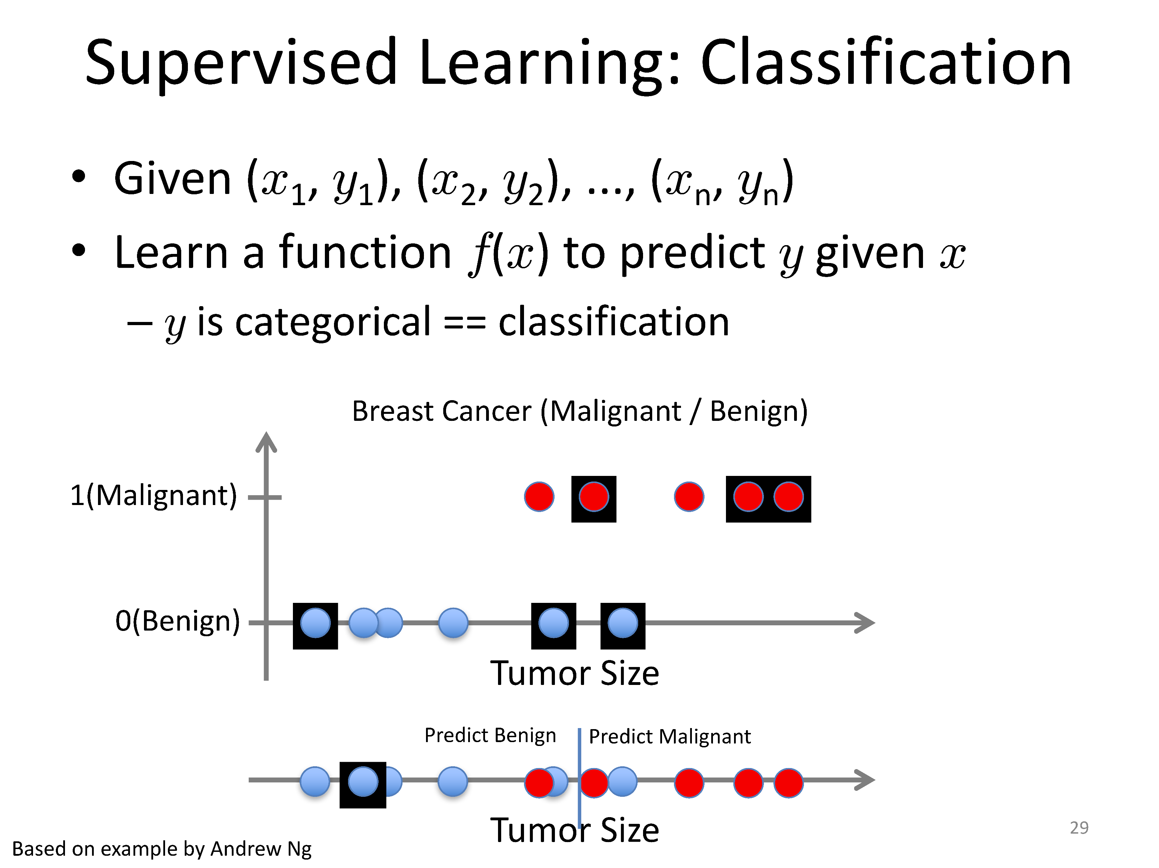

Slide 12
Customer ID | Age | Income ($1000s) | Education Level | Previous Purchases | Marital Status | Buy Product (Target)
1 | 25 | 40 | Bachelor's | 2 | Single | No
2 | 45 | 80 | Master's | 10 | Married | Yes
3 | 35 | 60 | PhD | 5 | Single | No
4 | 50 | 100 | Bachelor's | 8 | Married | Yes
5 | 30 | 45 | High School | 1 | Divorced | No
6 | 40 | 70 | Master's | 6 | Married | Yes
7 | 28 | 50 | Bachelor's | 3 | Single | No
8 | 55 | 90 | PhD | 12 | Widowed | Yes
9 | 32 | 55 | High School | 4 | Married | No
10 | 42 | 75 | Master's | 7 | Single | Yes
Patient ID | Fever (°C) | Headache | Muscle Pain | Nausea | Rash | Diarrhea | Disease (Target)
1 | 38.5 | Yes | Yes | Yes | No | No | Malaria
2 | 39 | Yes | Yes | No | No | Yes | Typhoid
3 | 37.8 | No | Yes | No | No | No | Malaria
4 | 40.2 | Yes | Yes | Yes | Yes | No | Typhoid
5 | 38 | No | No | Yes | No | Yes | Typhoid
6 | 39.5 | Yes | No | No | Yes | No | Typhoid
7 | 37.5 | No | Yes | No | No | No | Malaria
8 | 38.8 | Yes | No | Yes | No | No | Malaria
9 | 39.2 | Yes | Yes | No | Yes | Yes | Typhoid
10 | 38.3 | No | No | No | No | Yes | Typhoid

Slide 13
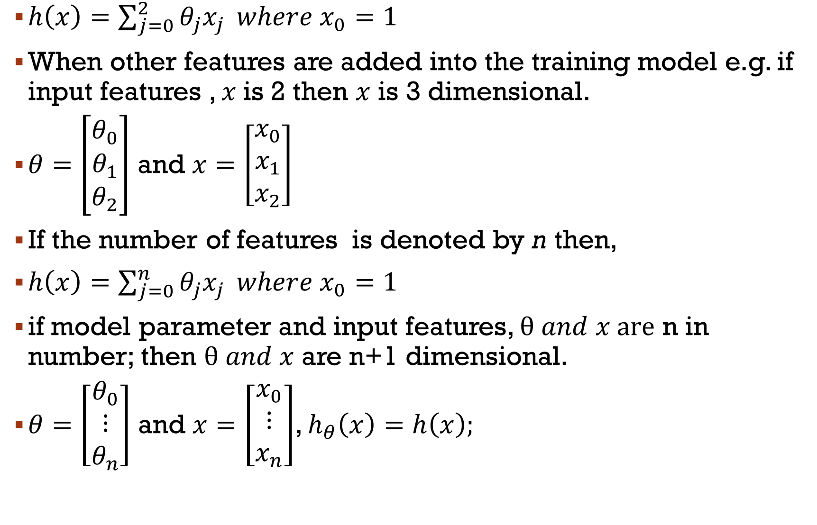
Notation to know
$h\left(x\right)=\sum_{j=0}^{2}{θ_{j}x_{j}} where x_{0}=1$
When other features are added into the training model e.g. if input features , $x$is 2 then $x$ is 3 dimensional.
$θ=\left[\begin{matrix}θ_{0} \\ θ_{1} \\ θ_{2}\end{matrix}\right]$ and $x=\left[\begin{matrix}x_{0} \\ x_{1} \\ x_{2}\end{matrix}\right]$
If the number of features is denoted by n then,
$h\left(x\right)=\sum_{j=0}^{n}{θ_{j}x_{j}} where x_{0}=1$
if model parameter and input features, $θ and x are$ n in number; then $θ and x$ are n+1 dimensional.
$θ=\left[\begin{matrix}θ_{0} \\ ⋮ \\ θ_{n}\end{matrix}\right]$ and $x=\left[\begin{matrix}x_{0} \\ ⋮ \\ x_{n}\end{matrix}\right]$, $h_{θ}\left(x\right)=h\left(x\right);$

Slide 14
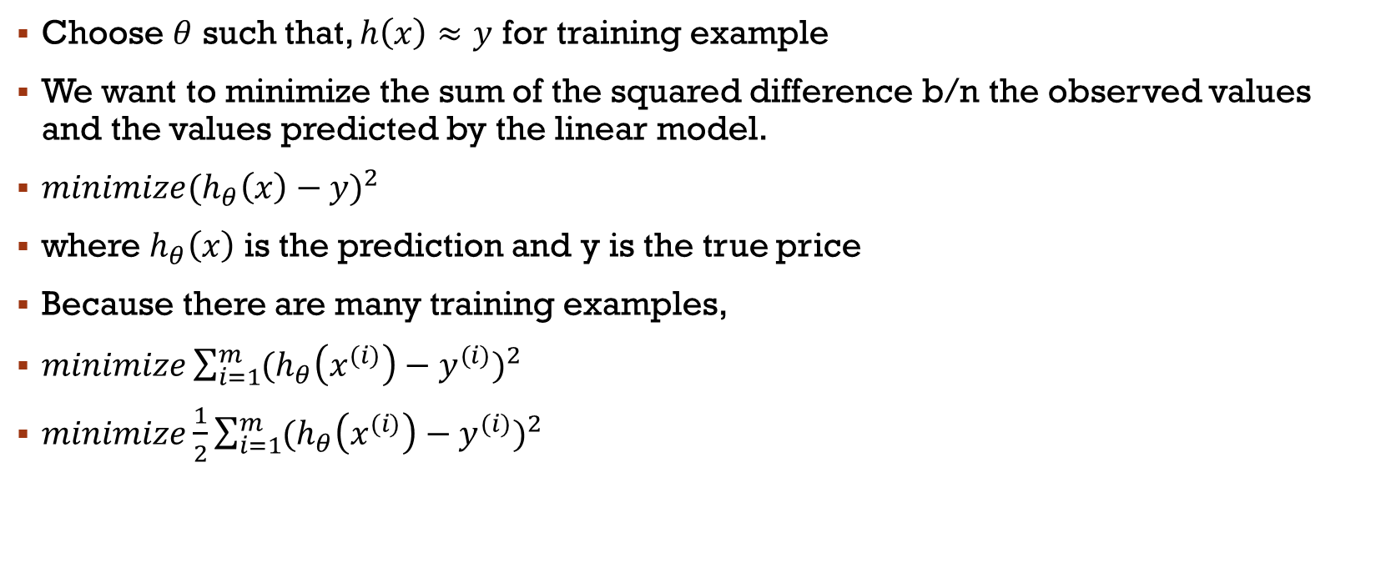




How do you choose $θ (paramter)$?
Choose $θ$ such that, $h\left(x\right)≈y$ for training example
We want to minimize the sum of the squared difference b/n the observed values and the values predicted by the linear model.
${minimize(h_{θ}\left(x\right)−y)}^{2}$
where $h_{θ}\left(x\right)$ is the prediction and y is the true price
Because there are many training examples,
$minimize\sum_{i=1}^{m}{{(h_{θ}\left(x^{(i)}\right)−y^{(i)})}^{2}}$
$minimize\frac{1}{2}\sum_{i=1}^{m}{{(h_{θ}\left(x^{(i)}\right)−y^{(i)})}^{2}}$
$$θ$$
$$θ$$
$$θ$$

Slide 15

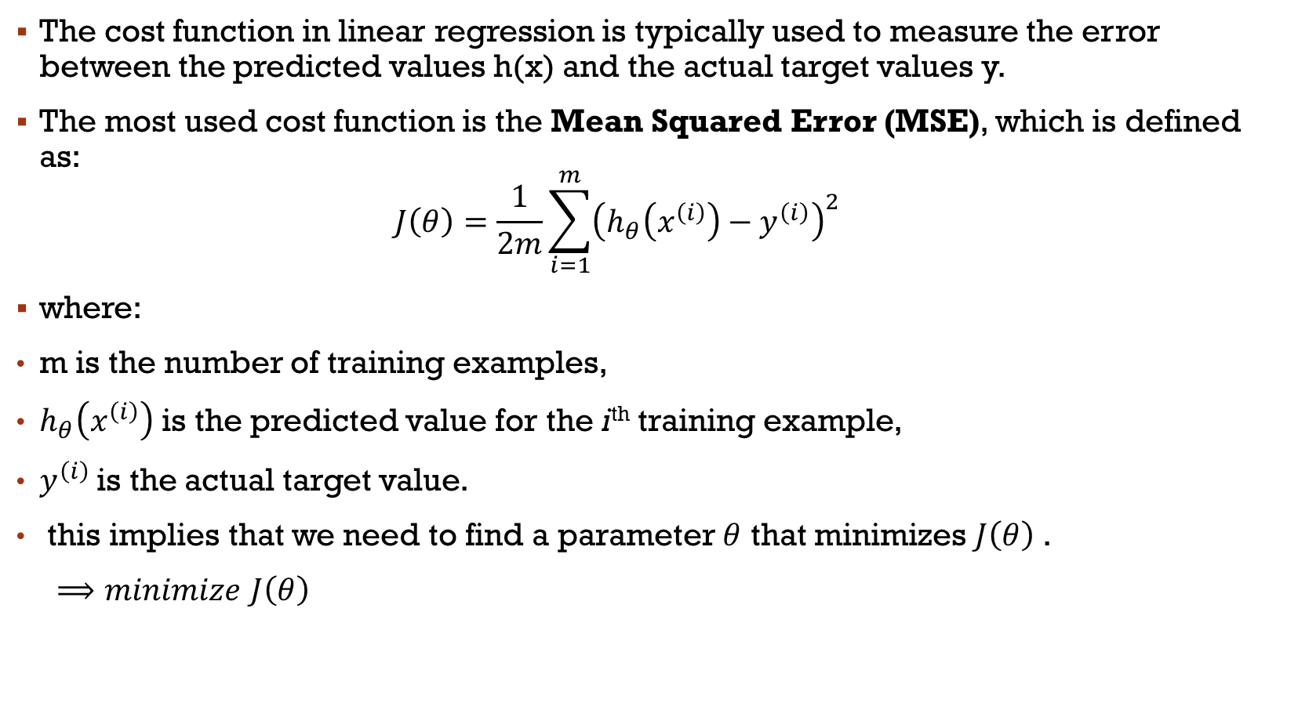
The cost function
The cost function in linear regression is typically used to measure the error between the predicted values h(x) and the actual target values y.
The most used cost function is the Mean Squared Error (MSE), which is defined as:
$$J\left(θ\right)=\frac{1}{2m}\sum_{i=1}^{m}{{\left(h_{θ}\left(x^{\left(i\right)}\right)−y^{\left(i\right)}\right)}^{2}}$$
where:
m is the number of training examples,
$h_{θ}\left(x^{\left(i\right)}\right)$ is the predicted value for the i^{th} training example,
$y^{\left(i\right)}$is the actual target value.
this implies that we need to find a parameter $θ$ that minimizes $J\left(θ\right)$ .
$⟹minimize$ $J\left(θ\right)$
$$θ$$

Slide 16

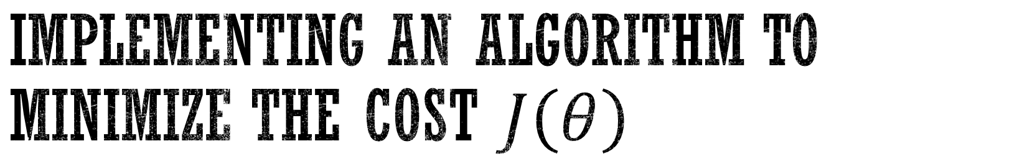
Implementing an algorithm to minimize the cost $J\left(θ\right)$
Gradient Descent
Start with some value of $θ$, say $θ=\overset{⃑}{0}$
Keep changing $θ$ to reduce $J\left(θ\right)$.
Denotes a vector with all zeros

Slide 17
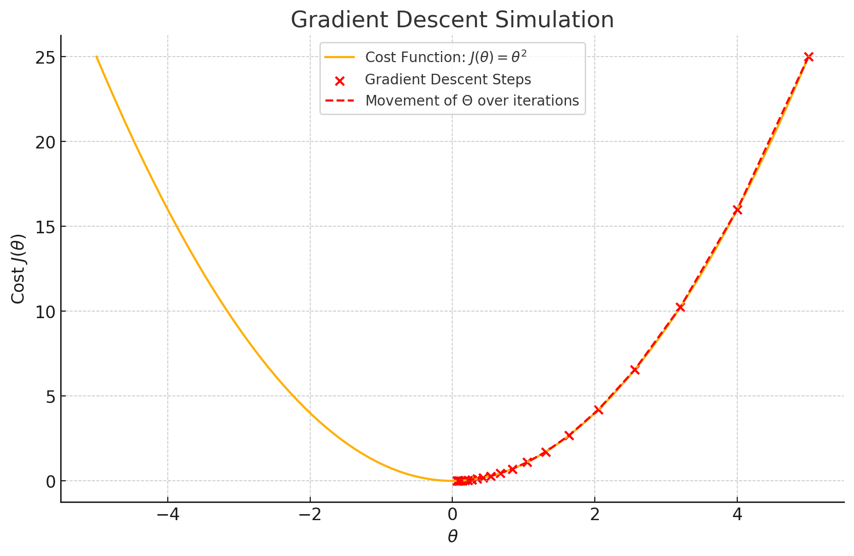

Slide 18
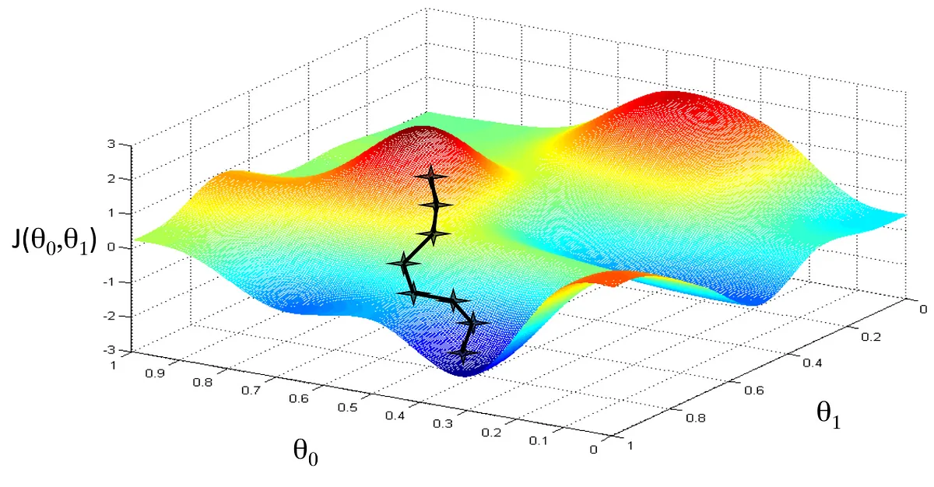

Slide 19
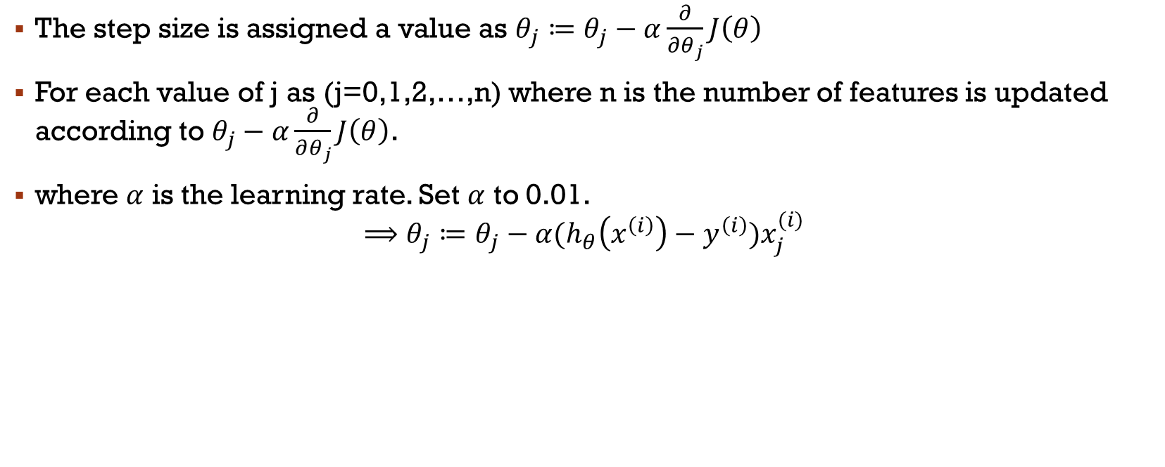
Step size of gradient descent
The step size is assigned a value as $θ_{j}≔θ_{j}−α\frac{∂}{∂θ_{j}}J\left(θ\right)$
For each value of j as (j=0,1,2,…,n) where n is the number of features is updated according to $θ_{j}−α\frac{∂}{∂θ_{j}}J\left(θ\right)$.
where $α$ is the learning rate. Set $α$ to 0.01.
$$⟹θ_{j}≔θ_{j}−α{(h}_{θ}\left(x^{\left(i\right)}\right)−y^{\left(i\right)})x_{j}^{(i)}$$
Notes:
The assignement sign means we take the value of the right and assign it to $θ$on the left.

Slide 20

Stochastic gradient
For i=1 to m$\{$
$θ_{j}≔θ_{j}−α{(h}_{θ}\left(x^{\left(i\right)}\right)−y^{\left(i\right)})x_{j}^{(i)}$
}

